Slide 1

Cultivating Your Career
Jonathan Mills

Slide 2

Who Is This Guy?
Practice Director / AdventureTech
@jonathanfmills
Jonathanfmills.com

Slide 3

Notes:
What do you want to get out of this?

Slide 4

Acres Of Diamonds

Slide 5


Slide 6
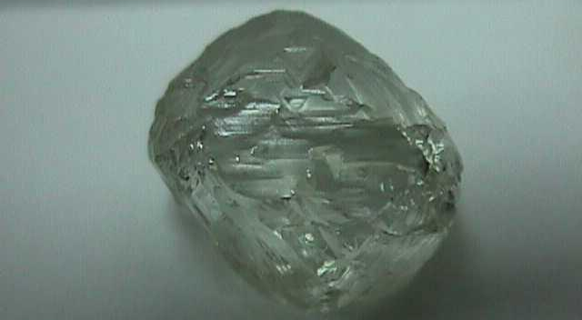

Slide 7
There are 10 types of people
On the job market….
Those who understand
binary and those who don’t…

Slide 8
2 Types Of People…

Slide 9
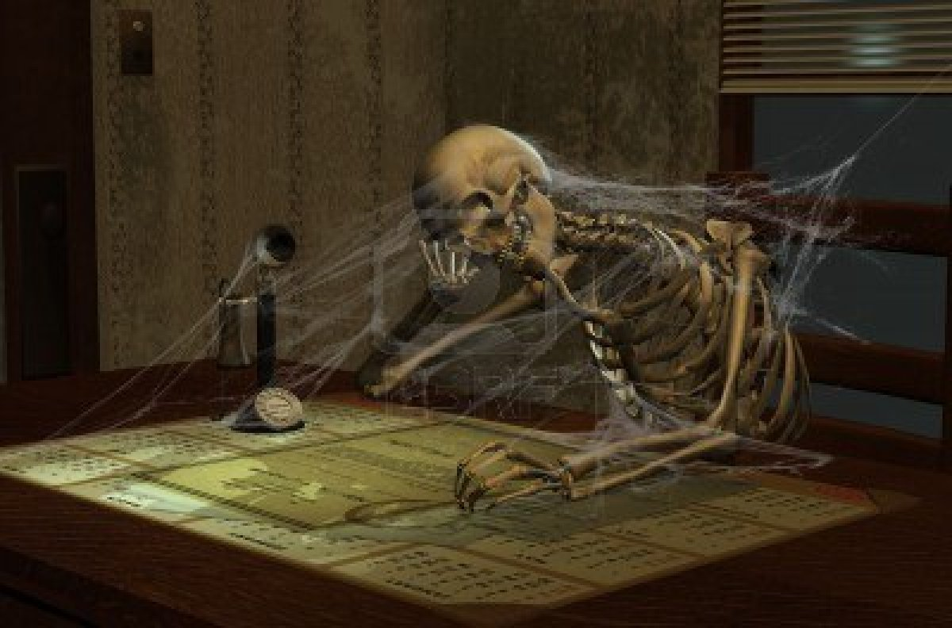
Stick it out….

Slide 10
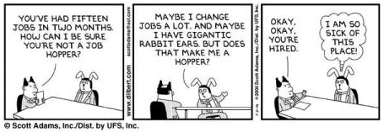
Job Hopper….

Slide 11
Be Intentional…

Slide 12
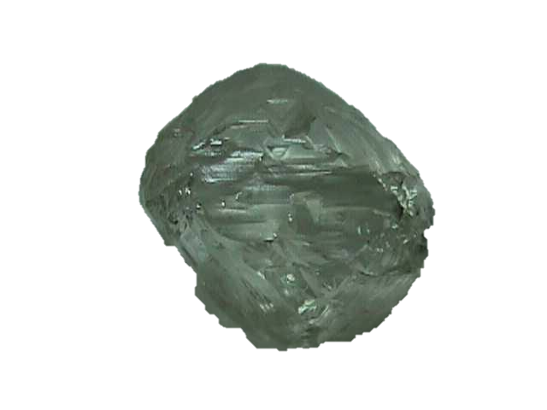
He didn’t know what he was looking for….

Slide 13

What do you want to be when you grow up?

Slide 14
What do you want to do when you grow up?

Slide 15

What is your sentence?

Slide 16

What if I don’t know anything about that???

Slide 17
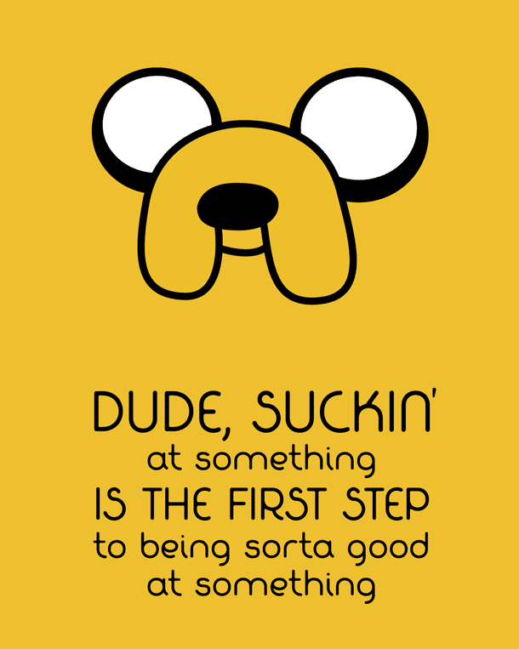

Slide 18

“Our research into human strengths does not support the extreme, and extremely misleading, assertion that 'you can play any role you set your mind to,' “

Slide 19
“…but it does lead us to this truth: Whatever you set your mind to, you will be most successful when you craft your role to play to your signature talents most of the time.”

Slide 20

Find people who are where
you want to be,
and buy them coffee…..
Notes:
Best buy story

Slide 21

He didn’t know where to look…

Slide 22
Start With Where You Are

Slide 23


Slide 24
Rules For Recruiters….
If they don’t interview you,
don’t interview for them….
Never Pay For Their Help….
They Should Be Transparent with You…
They Should Know What
You Should Expect…

Slide 25

Networking

Slide 26
Networking Rules….
Never be fake….
Use the tools available….
Meet a need….
Notes:
Meet a need, phil and the car
Meet a need, dinner in seatle… asking people to go with you.

Slide 27
Its not who you know….
Its who knows you…

Slide 28
Personal Relationships are the fertile soil from which all advancement, all success, all achievement in real life grows.
-- Ben Stein

Slide 29
He wouldn’t know what to do with it if he found it….

Slide 30
Would you hire you?

Slide 31
Questions?

